Slide 1
Study Unit 4 Data Management

Slide 2
Import Data

Slide 3
pandas Package
“pandas” is the most common package for data management in Python.
First, installing pandas using pip, then import pandas in our program:
import pandas as pd

Slide 4
Import Data
We need Python compatible datasets to work with pandas.
Load a dataset in Python and open it in the format of pandas.
Convert .csv data files to pandas DataFrame by the read_csv() function.
read_csv() is a reader to convert specific format of data files into pandas DataFrame.
pandas also provides readers to import data files from other sources such as Excel, SPSS, Stata, etc.
DataFrame_name = pd.read_csv("csv_file_name.csv")

Slide 5
pandas Readers
Reader | Format Type | Data Description
read_csv() | text | CSV
read_html() | text | HTML
read_clipboard() | text | Local clipboard
read_excel() | binary | MS Excel
read_stata() | binary | Stata
read_sas() | binary | SAS
read_spss() | binary | SPSS
read_pickle() | binary | Python Pickle Format
read_sql() | SQL | SQL
read_gbq() | SQL | Google BigQuery

Slide 6
Display pandas DataFrames
We can use the print() function to display the whole DataFrame.
Alternatively, display() function achieves the same.
Another possibility is to print the DataFrames without any function.
Use the .head() method to display the first five rows of a DataFrame.
print(DataFrame_name)
display(DataFrame_name)
DataFrame_name
DataFrame_name.head()

Slide 7
Data Selection

Slide 8
Select Columns by Variables
Create a list of variable names to select specific columns of a DataFrame.
The variable names must be put within a pair of quotation marks.
To access one column, put the variable name as string inside the index operator directly.
DataFrame_name[["var_name1", "var_name2", …]]

Slide 9
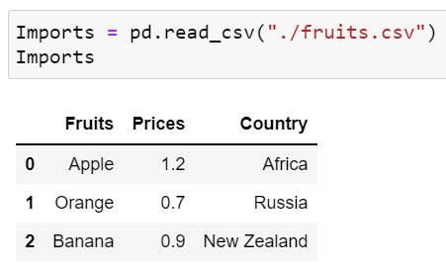
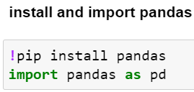
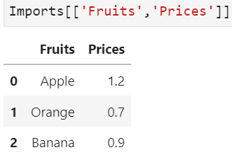
Example of column selection
Suppose we have a dataset on fruits, prices, and country of origin
imported as Pandas dataframe and named as Imports
You may use your own path to the file
To get the fruits and their prices, we use Imports[[‘Fruits’, ‘Prices’]]

Slide 10
Select Rows by Positions
We cannot refer to natural “observation names” to selecting rows.
pandas provides a row index to every row.
It starts with 0 and ends with the number of rows minus one.
Rows can be queried by the numeric index position using the DataFrame attribute iloc.
The indices must be integers, but they do not need to be consecutive.
If we select multiple rows, the indices must be put in a list first.
If we select one row, the index can be put in the index operator directly.
DataFrame_name.iloc[start:end]

Slide 11
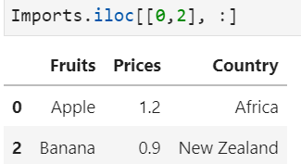
Example of row selection
First row and third row of imports, keep all columns
[0, 2] indicates the first and third rows of Imports
The ‘ : ’ after the comma indicates all columns

Slide 12
Select Rows by Indices
Another way to select rows is to use row index labels.
Create row index labels by the method .set_index().
This method converts the values of a variable to row index labels.
The rows can be queried by the row index labels using the .loc attribute.
Put row labels as strings in a list for selecting multiple rows.
To select rows of a single label, put the label in .loc directly.
DataFrame_name.set_index(key, inplace = True)
DataFrame_name.loc[["row_label1", "row_label2", …]]

Slide 13
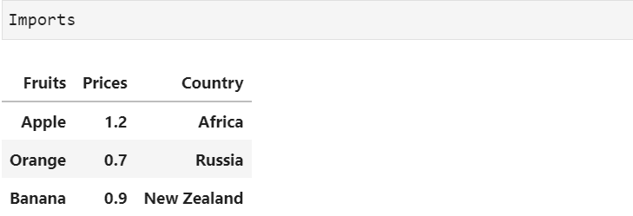
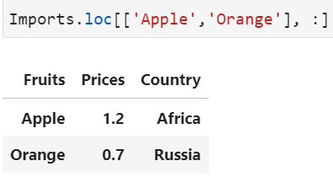
Example of using row indices
Use the variable names as a key for Imports; use one column as the row index label
Then, we locate the ‘Apple’ and ‘Orange’ rows

Slide 14
Select Cells by Positions and Indices
Specify columns and rows by the .loc and/or .iloc attributes to select cells from a DataFrame.
Use one of the following syntaxes to select cells from a DataFrame:
DF_name.iloc[row_start:row_end, col_start:col_end]
DF_name.loc[["row_labels"], ["col_labels"]]
DF_name[["col_labels"]].iloc[row_start:row_end]
DF_name.loc[["row_labels"]].iloc[0:, col_start:col_end]

Slide 15
Select Cells by Boolean Masking
The elements of a Boolean mask array are either True or False.
Boolean mask array is overlaid on top of the queried DataFrame.
Elements aligned with True are selected.
More complex queries with several conditions are connected by bitwise logical operators.
If there are two conditions, two Boolean masks will be compared elementwise by the bitwise operator.
Each condition needs to be encased in parentheses.
DataFrame_name[Condition]
DataFrame_name[(Condition1) &/| (Condition2) &/| …]

Slide 16
First Activity
Car sales program:
Carry out the following tasks in JupyterLab:
Read in the data file “car_model.csv” into Python as a pandas DataFrame. The data file contains 4 variables: Year, Make, Model, and Category.
Print the DataFrame and check on its dimension.

Slide 17
Discussion
What are the main differences between a dataset (or pandas DataFrames) and an array (or NumPy array)?
How different are the outputs of a DataFrame resulting from the different printing functions in Python? Which one is most/least preferrable when using JupyterLab or jupyter notebook as our programming environment?

Slide 18
Second Activity
Car sales program:
Carry out the following tasks in JupyterLab:
Select the column (variable) “Make” from the DataFrame.
Select all entries with the value “Audi” in the variable “Make” from the DataFrame.
Select the last 10 observations and only the variable “Year” from the DataFrame.

Slide 19
Discussion
Name situations where we would need to select data from a DataFrame.
How different are the syntaxes between row and column selections.

Slide 20
Merge DataFrames (This section on data frames is optional)

Slide 21
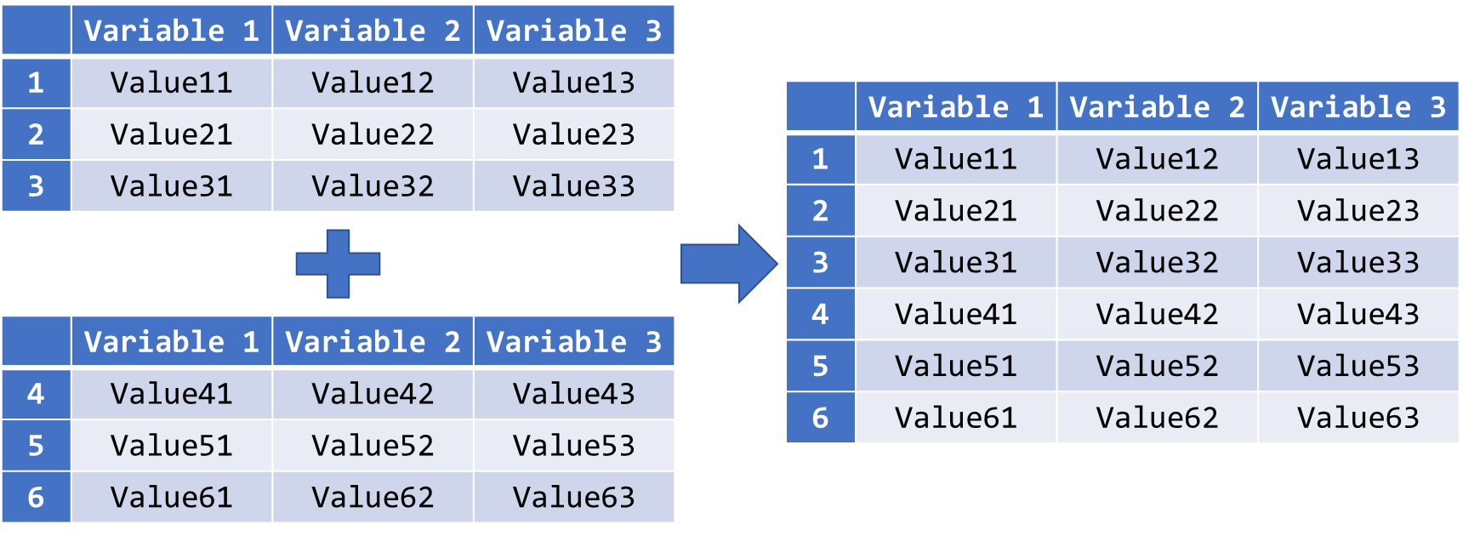
Append DataFrames by Rows
Concatenate two DataFrames with identical variables by rows:
Use the .append() method for such concatenation:
DataFrame_name.append(other = [OtherDataFrames])

Slide 22
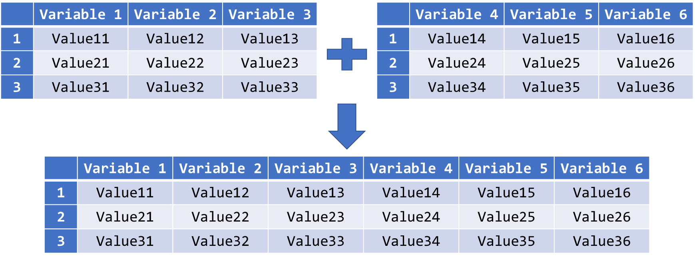
Merge DataFrames by Columns
Merge two DataFrames with identical observations by columns:

Slide 23
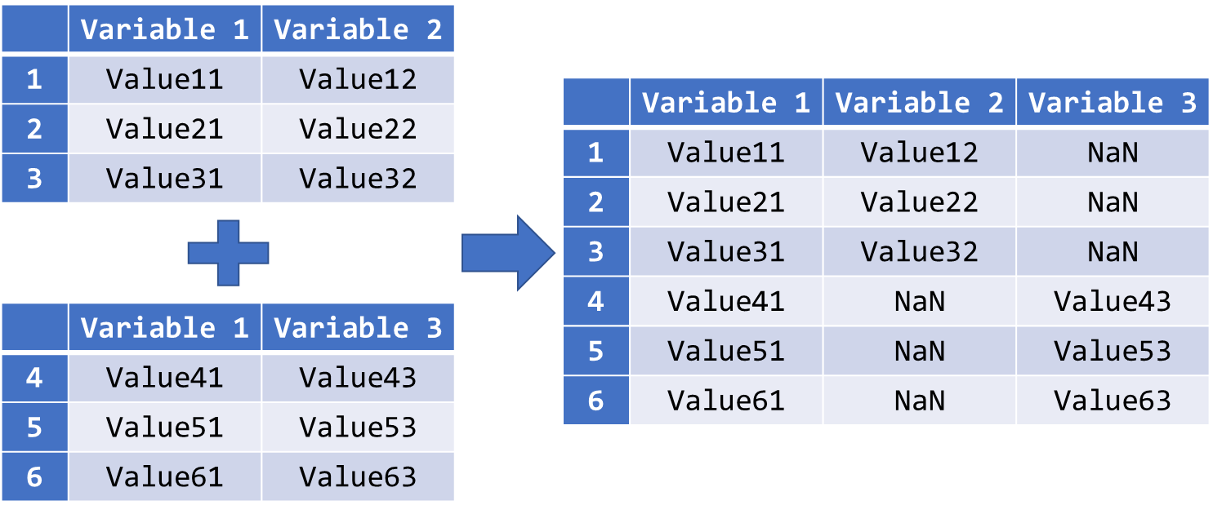
Outer Join DataFrames with Some Common Variables
Outer join two DataFrames with some common variables:

Slide 24
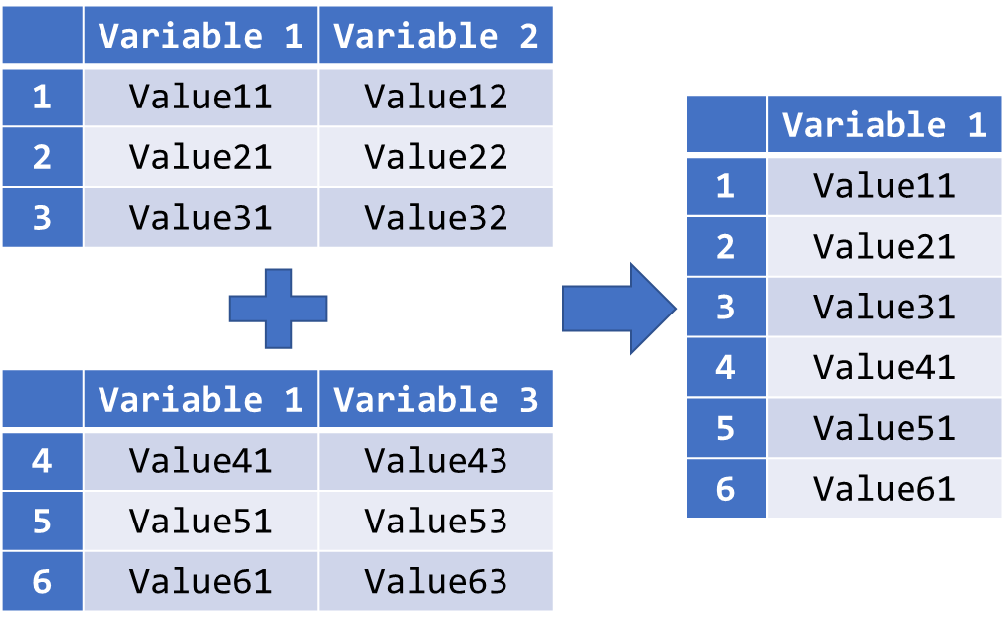
Inner Join DataFrames with Some Common Variables
Inner join two DataFrames with some common variables:

Slide 25
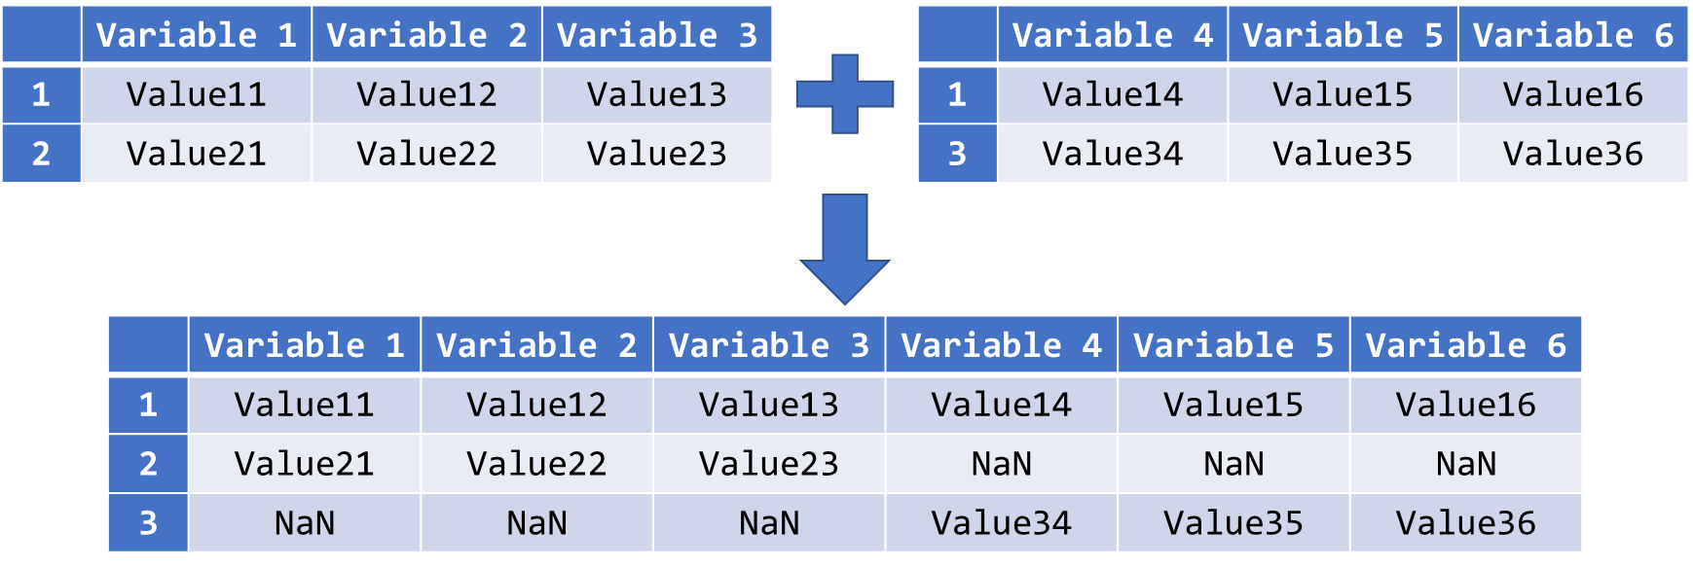
Outer Join DataFrames with Some Common Observations
Outer join two DataFrames with some common observations:

Slide 26
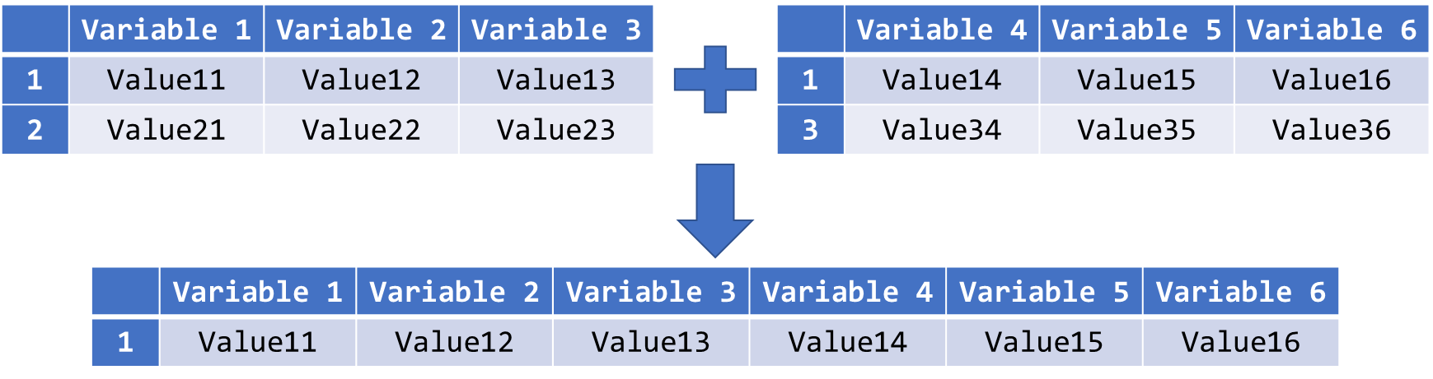
Inner Join DataFrames with Some Common Observations
Inner join two DataFrames with some common observations:

Slide 27
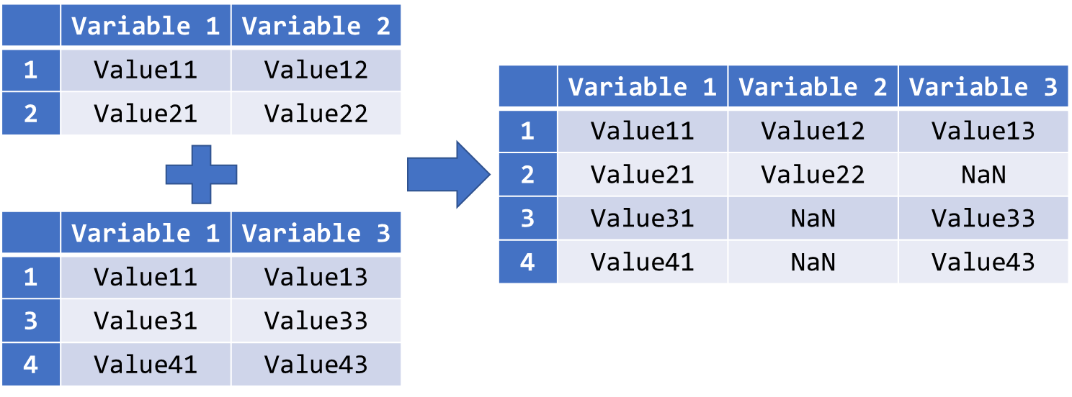
Outer Join DataFrames with Different Shapes
Outer join two DataFrames with different shapes:

Slide 28
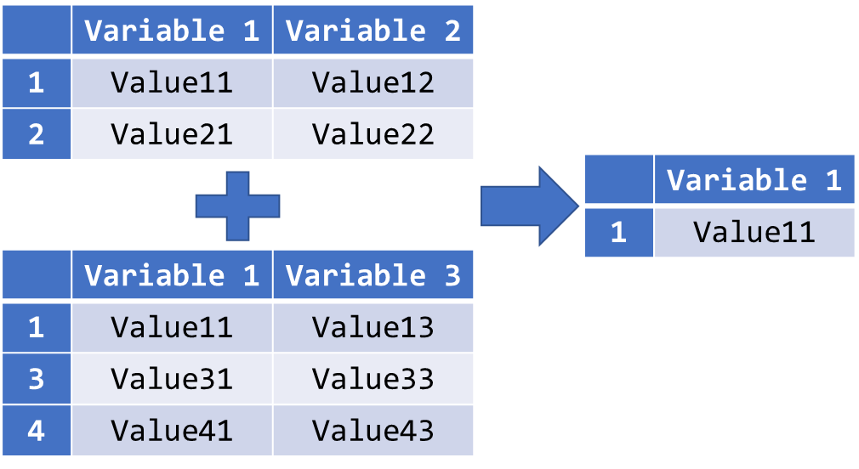
Inner Join DataFrames with Different Shapes
Inner join two DataFrames with different shapes:

Slide 29
Concatenate DataFrames
Use concat() to merge multiple DataFrames with different shapes.
The names of the DataFrames to be concatenated must be put in a list.
If axis = 0, the DataFrames will be concatenated below one another, and the concatenation will take place beside one another if axis = 1.
The join parameter controls the type of concatenation. The possible values here are "outer" and "inner", written as string.
finalDF_name = pd.concat(objs, axis, join)

Slide 30
Third Activity
Car sales program:
Carry out the following tasks in JupyterLab:
Read in the usual data file “car_model.csv” into Python.
Then read in car_price_model.csv” into Python. The data file contains 4 variables: Year, Make, Model, and Price (in USD).
Inner join the “car_model” and “car_price_model” data by their “year”, “make” and “model”.
Outer join the “car_model” and “car_price_model” data
Print the merged DataFrame

Slide 31
Missing Data and Outliers

Slide 32
Missing Data
In empirical studies, an observed value of a variable could be missing.
Reasons for missing data: defective measurement tools, withdrawal from the study, refusal of responses to sensitive questions, etc.
In Python, pandas indicates missing data with a special floating-point value, while NumPy uses NaN (“Not a Number”).
Missing data cannot be included in constructing models, forecasting, etc.
In pandas, missing values are ignored by the statistical functions.
Since the underlying sample sizes for each variable could vary in the computation due to missing data, the statistical estimation can be biased.

Slide 33
Identify Missing Data
pandas’ readers such as read_csv() have two parameters, na_filter and na_values, to convert certain strings to missing values directly.
By default na_filter is True, pandas will convert all white spaces "" to NaN.
With na_values, we can declare certain strings from our DataFrame to be recognised as missing values.
The following strings are treated as missing values by default and do not require explicit declaration:
"", "#N/A", "#N/A N/A", "#NA", "-1.#IND", "-1.#QNAN", "-NaN", "-nan", "1.#IND", "1.#QNAN", "N/A", "NA", "NULL", "NaN", "n/a", "nan", "null"
DataFrame_name = pd.read_csv("csv_file_name.csv", na_values = "na_string", na_filter = True/False)

Slide 34
Locate Missing Data (I)
It is often not easy to locate the missing data in a dataset.
Count the NaNs in each row and each column to find the missing data.
Missing values exist in a variable if the number of NaNs is larger than zero.
Same approach is applicable to rows.
The method .isnull() checks every cell of a DataFrame and returns True if the cell contains a missing value and False otherwise.
The method .sum() adds up all the “True” (equal to 1) in each row or each column. It is equivalent to counting the missing values.
If axis = 0, the values in a column will be added up together. If axis = 1, it returns the sum of a row.
DataFrame_name.isnull().sum(axis = 0/1)

Slide 35
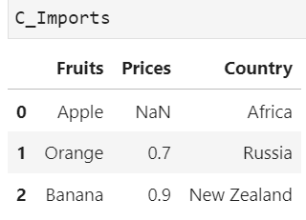
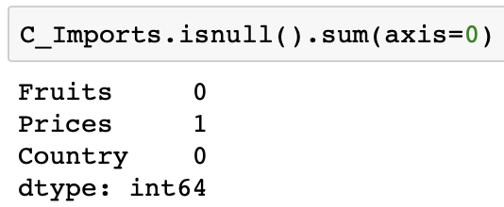
Example of Locating Missing Data (I)
Suppose our Imports dataset is corrupted, name it as C_Imports
Observe that the price of apple is missing, NaN
Now locate the missing data; there is 1 missing value in Prices

Slide 36
Locate Missing Data (II)
We can use .any() just to check whether missing data exist.
It returns True if any element in the attached array is True.
Retrieve the row/column indices with missing data by .index.
Counting the NaNs in columns means to check on the existence of missing values in each variable.
Counting the NaNs in rows means to identify observations with missing values in at least one of the variables.
The treatments of missing data are different in these two cases.
DataFrame_name.isnull().any(axis = 0)
DataFrame_name.isnull().any(axis = 1)
or
object_name = DataFrame_name.isnull().any()
object_name[object_name == True].index

Slide 37
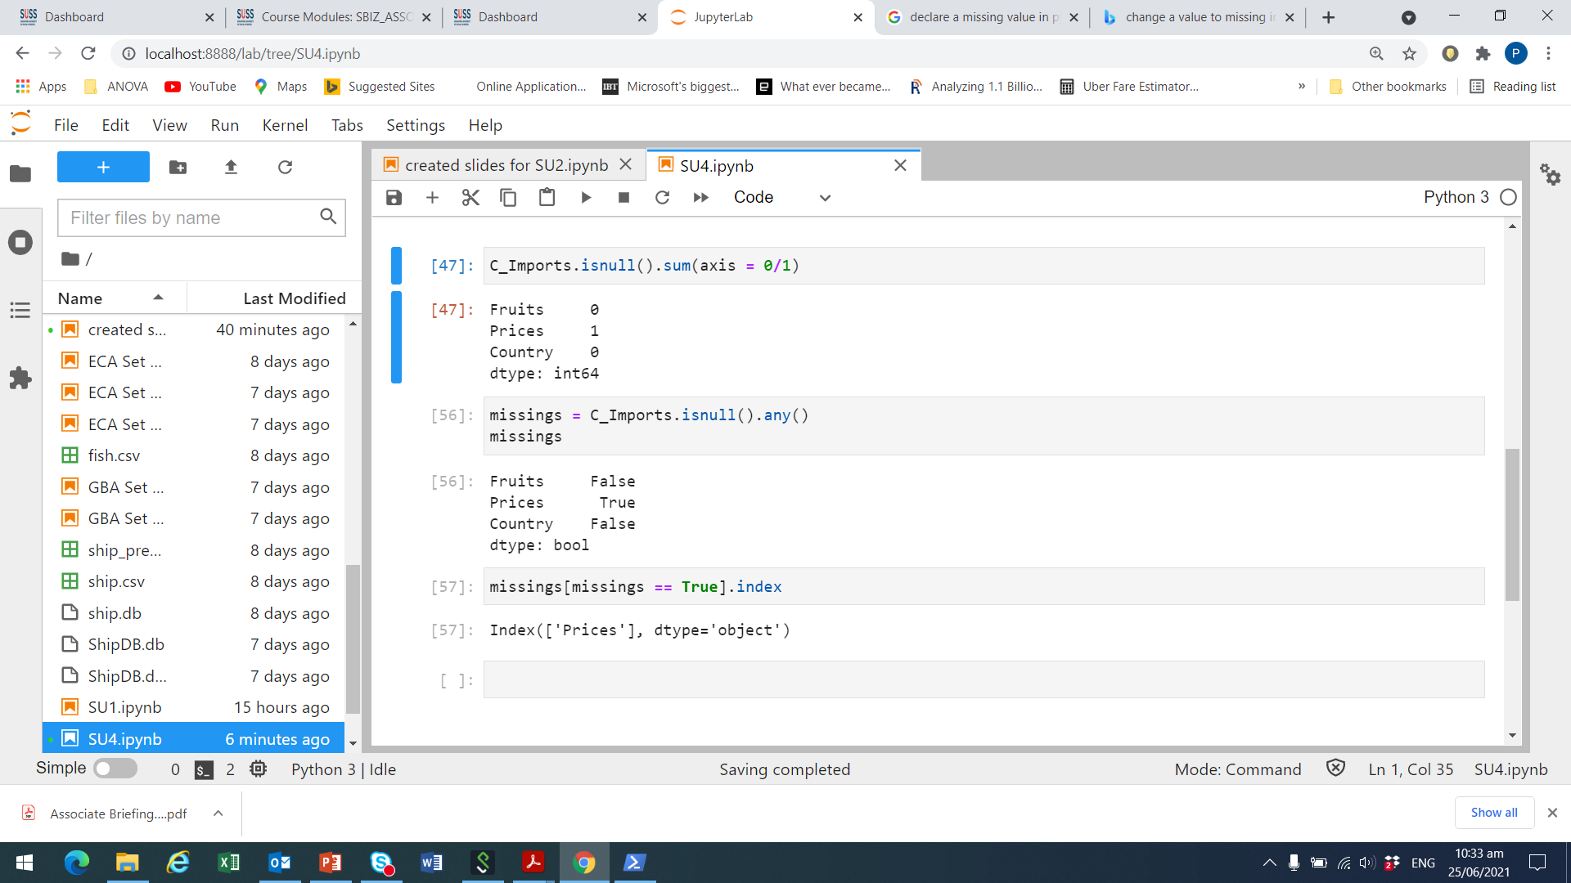
Example of Locating Missing Data (II)
Check for missing entries in C_Imports. Recall that price is missing
We see a ‘True’ for ‘Prices’
Now check the index which is missing
We see a ‘True’ for ‘Prices’

Slide 38
Delete Missing Data
The usual ways to treat missing data are:
delete the entire observations
replace them
ignore them
With .drop(), we specify the row indices with missing values that should be removed.
The .dropna() method combines the localisation and removal of rows or columns with missing data in a single function.
All missing values are treated and deleted by .dropna() equally.
DF_name.drop(axis = 0, index = [index1, index2, …])
DF_name.dropna(axis = 0, how = "any"/"all")

Slide 39
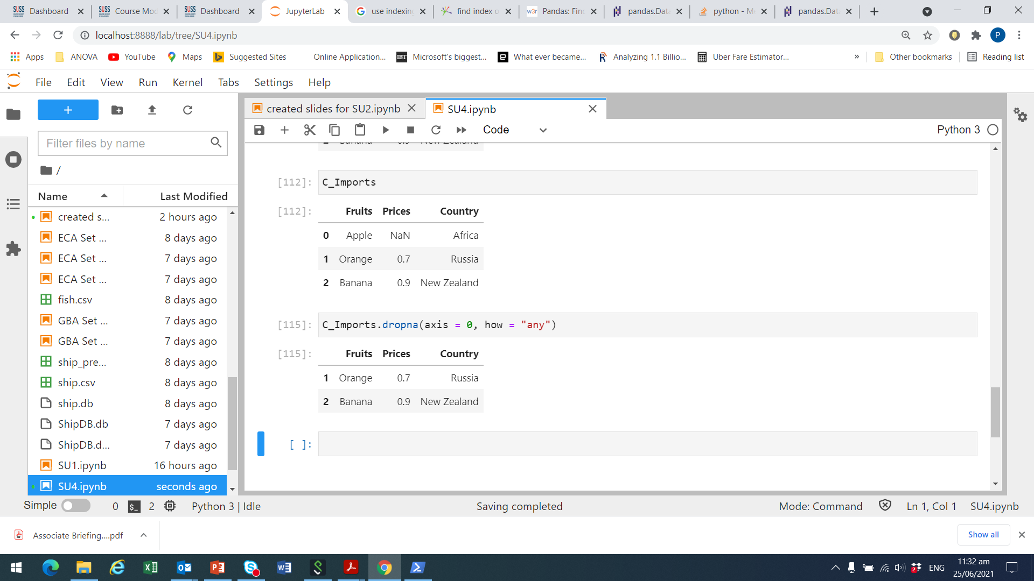
Example of Deleting Missing Data
Recall that Prices for Apple is missing in C_Imports.
We set how = “any” to drop the row for Apple with NaN for Prices.

Slide 40
Replace Missing Data
We can also replace missing values by a pre-defined value.
The most common values are 0 or the variable mean.
pandas facilitates replacement of missing values by .fillna().
The .fillna() method replaces all missing values with the value specified in the parameter.
We can also specify a column in the DataFrame where the missing values should be replaced by the .fillna() method.
DataFrame_name.fillna(value = repl_value)
DataFrame_name["column_label"].fillna(value = repl_value)

Slide 41
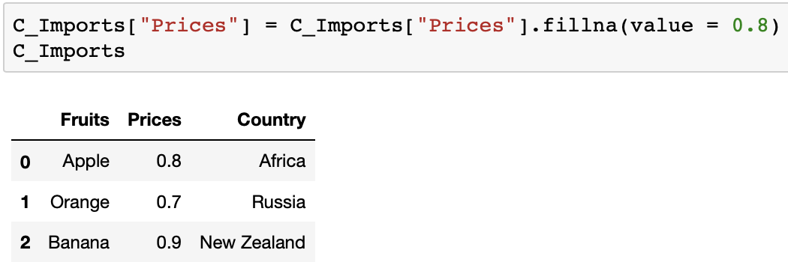
Example of Replacement
Recall that Prices for Apple is missing in C_Imports (i.e., NaN)
Replace NaN with the mean price of orange and banana
Mean is (.7 + .9) / 2 = .8

Slide 42
Outliers
Outliers can cause biasedness in the statistical estimation.
Draw histogram/boxplot or use interquartile range (IQR) to detect outliers in a variable.
Use .quantile() to determine the 1st and 3rd quartiles of a variable.
An observation y is considered as outliers if:
y < q1 – 1.5 * iqr or y > q3 + 1.5 * iqr
where q1 is the 1st quartile, q3 the third quartile and iqr = q3 – q1 is the interquartile range.
DataFrame_name["column_label"].quantile(q = quantile)

Slide 43
Detect and Remove Outliers
Usually, outliers should be removed from the dataset.
In Python, it suffices to select observations with no outliers in the target variable.
The following syntax generates a subset of rows that do not fulfil the outlier condition.
DF[~((DF["Col"]<q1–1.5*iqr) | (DF["Col"]>q3+1.5*iqr))]

Slide 44
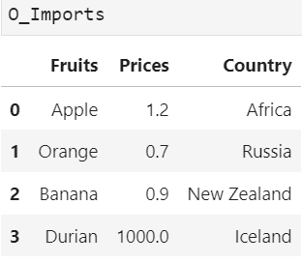
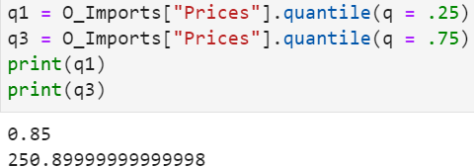
Example of Outliers (I)
Suppose our fruit imports dataset, ‘O_Imports’, now has 1 outlier
Durian with Prices of 1,000, from Ukraine; looks suspicious
Obtain the 1st quantile (q = .25) and 3rd quantile (q = .75)

Slide 45
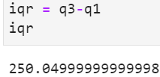
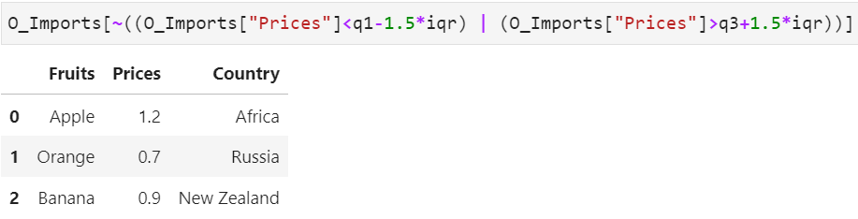
Example of Outliers (II)
Define interquartile range, iqr, as q3 – q1
Find the observations which are not outliers
Hence, Durians from Iceland with a Price of 1,000 is an outlier

Slide 46
Fourth Activity
Car sales program:
Carry out the following tasks in JupyterLab:
Remove all the rows with missing data in “price” from the merged DataFrame created in the previous chapter.
Detect car models that can be considered as outliers in terms of their selling price.
Discuss whether the models with extraordinarily high/low selling prices should be excluded from the DataFrame.

Slide 47
Data Modification

Slide 48
Sort Data
Sometimes, we may want to sort the data according to the values of some variables for better understanding.
The method .sort_values() rearranges the order of the rows in a DataFrame.
A list of variable names based on which the DataFrame is sorted must be provided.
The sorting hierarchy among these variables drops with the increasing index in the list.
Data can be sorted in the ascending or descending order.
DataFrame_name.sort_values( by = [List_of_var_names], ascending=True)

Slide 49
Discretisation
Through discretisation, variables are easier to understand or becomes compatible to some specific analytics models such as decision trees.
Use the cut() function to discretise continuous variables.
Note that the data to be discretised should be converted to a one-dimensional NumPy array in the first place.
DataFrame_name["column"] = pd.cut(x = array, bins, right, labels, include_lowest, ordered)

Slide 50
Grouping Data
Analysing aggregated statistics of some variables are often of interest in data analytics.
Aggregated statistics are calculated based on grouped data.
A DataFrame can be grouped by one or more variables using the .groupby() method.
Attached to the .groupby() method can be any method for the calculation of the aggregated statistics.
DataFrame_name.groupby(by = [List_of_Labels]).anymethod()

Slide 51
Transformation
Sometimes, we may need to transform the values of a variable.
For instance, log-transformation can help to stabilise the variance of a variable.
In Python, there are various functions to transform variables.
For example, the log-transformation of a numeric variable can be carried out by the log() function from the NumPy package.
DF_name["new_var"] = np.log(DF_name["var_name"])

Slide 52
Standardisation
Sometimes, variables included clustering could be measured at different scales and do not contribute equally to the analysis.
Hence, we need to standardise or normalise them.
The standardisation function can be found in the “scikit-learn” package.
To standardise a variable in the traditional way, we need to find the mean and the standard deviation of the variable first.
var_mean = np.mean(DF["var_name"])
var_std = np.std(DF["var_name"])
DF["std_var"] = (DF["var_name"] – var_mean) / var_std

Slide 53
Normalisation
Normalisation is another transformation method to scale down a variable.
The values of a normalised variable can only be in the interval [0, 1].
The normalisation function can also be found in the “scikit-learn” package.
To normalise a variable in the traditional, we need to find the minimum and maximum of the variable first.
var_min = np.min(DF["var_name"])
var_max = np.max(DF["var_name"])
DF["norm_var"] = (DF["var_name"] – var_min) / (var_max – var_min)

Slide 54
Fifth Activity
Car sales program:
Carry out the following tasks in JupyterLab:
Read in the data file “car_price_model.csv” into Python as a pandas DataFrame. The data file contains 4 variables: Year, Make, Model, and Price.
Print the DataFrame and check on its dimension.
Drop the rows where at least one element is missing.
Since the prices stored in the “Price” variable are in US dollars, add a new column named “SGD Price” that is 1.5 times of the “Price”
Calculate the mean price (in SGD) of each car Make

Slide 55
Discussion
What happens to the bin edges in the discretisation process using the cut() function?
When is log-transformation/normalisation/standardisation necessary? What is the main difference between normalisation and standardization?

